Slide 1
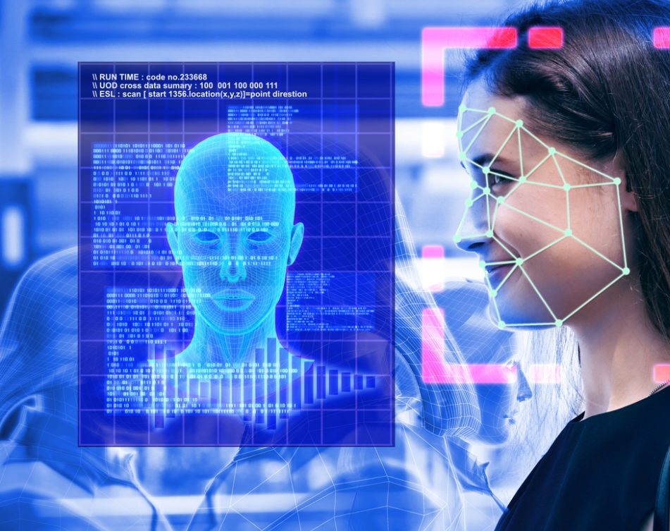
motion Detection System
EmotiSense: A Multi-Sensory Emotion Detection Framework
Integrating LLaMa, LLaVa,Wav2vec …

Slide 2

Team Members:
Krishnasai Bharadwaj Atmakuri – bka2bg@umsystem.edu
Mohammadreza Akbari Lor – ma7fy@umsystem.edu
Mohitha Lakshmi Dayana – mdhkc@umsystem.edu
Hema Nagini Matta – hm2np@umsystem.edu

Slide 3
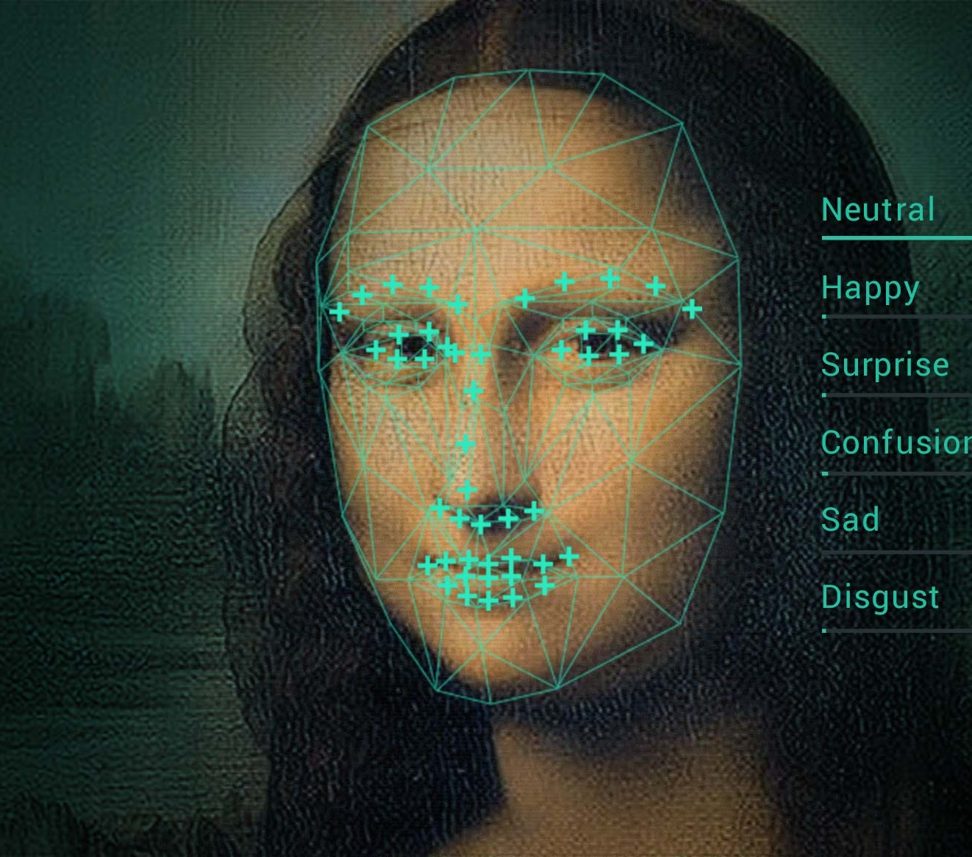

Problem Statement
The ability to accurately detect and interpret human emotions is a cornerstone in enhancing human-computer interaction. Traditional emotion detection systems have predominantly relied on single modalities, such as text analysis or facial recognition, leading to limitations in comprehensiveness and accuracy. The challenge arises from the complexity of human emotions, which are often conveyed through a combination of facial expressions, tone of voice, and verbal cues. Relying on a single modality can result in a significant loss of context and nuance, leading to misinterpretations. Furthermore, in a world that increasingly interacts digitally, the need for sophisticated emotion detection that mirrors human empathy and understanding has become paramount. This creates a significant opportunity to develop a more holistic, multimodal approach to emotion detection, leveraging advancements in large language models (LLMs) and machine learning.

Slide 4
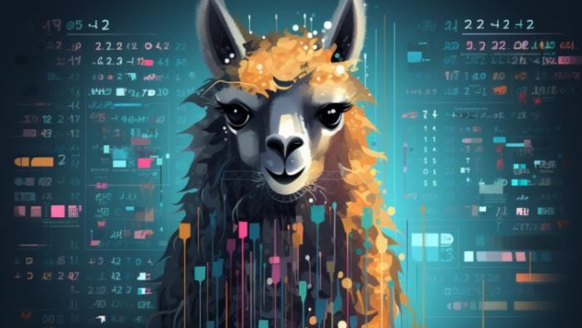
Project Overview
This project aims to address these challenges by developing a multimodal emotion detection model that integrates data from three primary sources: image, audio, and text. By combining the strengths of open-source Large Language Models (LLMs) like LLaMa, LLaVa, and Wav2vec, this model seeks to provide a more comprehensive and accurate representation of human emotions. The integration of these modalities presents a unique opportunity to capture the subtleties and complexities of emotional expression in a way that single-modality systems cannot.

Slide 5
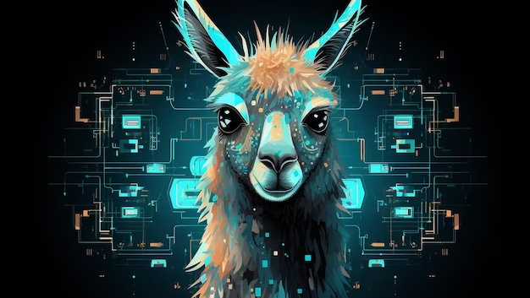
Continuation…..
Image Processing: Using LLaVa for the visual modality, the model will analyze visual cues from facial expressions and body language.
Audio Analysis: Wav2vec and similar tools will be employed to interpret vocal tonality, pitch, and other auditory signals that indicate emotional states.
Textual Interpretation: LLaMa will be used to understand the context and sentiment of spoken or written words, providing crucial insights into the emotional content.
The synergy of these modalities under a unified framework will enable the system to interpret emotions with a level of depth and precision akin to human interaction. This project is not just about advancing technology; it's about bridging the gap between digital interactions and human empathy, opening new frontiers in user experience, mental health, customer service, and beyond.

Slide 6

Data Collection
https://www.kaggle.com/datasets/sujaykapadnis/emotion-recognition-dataset
This image dataset consists of 6 distinct emotions : Happy, Angry, Sad, Neutral, Surprise and Ahegao.
Images are RGB and presented as cropped faces with corresponding emotions. The images were collected by scrapping social nets as Facebook and Instagram, scrapping YouTube videos and already available datasets as IMDB and AffectNet.
https://www.kaggle.com/datasets/uldisvalainis/audio-emotions
This audio dataset consists of 6 distinct emotions : Happy, Angry, Sad, Neutral, Fearful, Surprise and Disgusted. Recordings are in .wav format and are sorted in folders.
https://www.kaggle.com/datasets/zaber666/meld-dataset
Multimodal EmotionLines Dataset (MELD) has been created by enhancing and extending EmotionLines dataset. MELD contains the same dialogue instances available in EmotionLines, but it also encompasses audio and visual modality along with text. MELD has more than 1400 dialogues and 13000 utterances from Friends TV series. Multiple speakers participated in the dialogues. Each utterance in a dialogue has been labeled by any of these seven emotions -- Anger, Disgust, Sadness, Joy, Neutral, Surprise and Fear. MELD also has sentiment (positive, negative and neutral) annotation for each utterance.
https://www.kaggle.com/datasets/robertknuth/emotion-dataset-aaai16
This is the dataset provided by quanzeng.you(https://qzyou.github.io/). The corresponding paper is Building a Large Scale Dataset for Image Emotio cognition: The Fine Print and The Benchmark.
https://www.kaggle.com/datasets/omagarwal2411/nor-smart-speech
This is a dataset that contains 19,487 Audio(.wav) files divided into 6 emotions {'happy', 'sad', 'angry', 'surprise', 'neutral', 'fear’}. This dataset is a merged dataset that contains the audio files of above 6 emotions taken from the open source Speech Emotion Recognition datasets: RAVDESS, CREMA-D, TESS, SAVEE and ASVP-ESD.

Slide 7

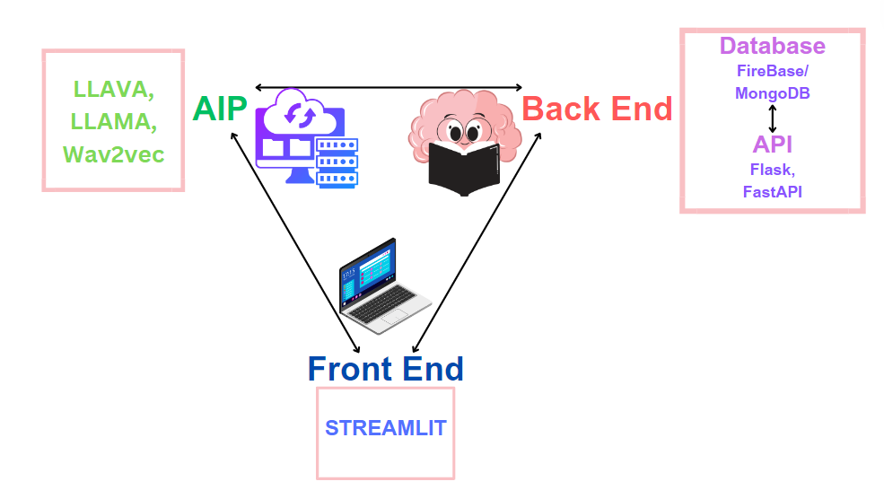
Architecture Diagram of EmotiSense

Slide 8

LLMs (Large Language Models):
LLaMa: This model will be primarily used for textual data analysis.
Wav2vec: This model is crucial for audio data analysis. It will be used to process and understand speech patterns, tonality, and other auditory cues indicative of emotional states.
LLaVa: This model will be primarily used for visual data analysis and image processing.
A significant aspect of our data sourcing strategy involves the integration of these modalities. We will develop a framework to synchronize data from text, audio, and image sources, ensuring that they can be effectively combined for multimodal analysis.

Slide 9

Integrating LLMs
Integration of Textual Data with LLaMa: Utilizing LLaMa for advanced sentiment analysis and natural language understanding. Techniques like transfer learning can be employed, where pre-trained models are further fine-tuned with our specific datasets.
Audio Processing with Wav2vec: Implementing Wav2vec for extracting meaningful features from audio data. Focus on capturing emotional cues like tone, pitch, and speech rhythm.
Integration of Visual Data with LLaVa: Utilizing LLaVa for Image processing and emotion detection from faces.
Synchronizing LLM Outputs with Other Modalities: Developing a framework for integrating the outputs of LLMs with image and audio data analysis. Ensuring that the data from different modalities aligns correctly and complements each other in the final emotion prediction.

Slide 10

Preliminary Analysis
Data Overview and Quality Check:
Explore the structure of the data stored in MongoDB.
Check for completeness, consistency, and any missing values in the multimodal dataset.
Assess the diversity of the dataset across different modalities (e.g., facial expressions, voice recordings, physiological signals).
Data Retrieval and integration:
Retrieve a subset of data from MongoDB for initial analysis.
Explore methods for efficiently integrating and aligning multimodal data.
Verify that data from different modalities are properly linked and can be processed together.
Data Visualization(Streamlit):
Develop Streamlit visualizations to provide an interactive overview of the dataset.
Create charts, graphs, or plots that represent the distribution of emotional states across modalities.
Allow users to explore individual instances or segments of the data.
FASTAPI Endpoints and Integration:
Confirm that FastAPI endpoints are set up to serve the necessary data to the front end.
Test the integration of FastAPI with MongoDB to ensure smooth data retrieval.
Monitor the performance of FastAPI in handling requests and responses.
LLAVA LLAVA Integration:
Evaluate the integration of LLAVA and LLAMA into the data processing pipeline.
Verify that LLAVA can handle audio data (e.g., voice recordings) and LLAMA can handle visual data (e.g., facial expressions).
Ensure that both tools contribute to a comprehensive understanding of emotions.
Wav2Vec Model Performance:
Assess the performance of the wav2vec model on the dataset.
Use metrics such as accuracy, precision, recall, and F1 score for emotion detection.
Analyze model outputs to identify any patterns or challenges in recognizing emotions.
Documentation and Logging:
Ensure that all components, including Streamlit, FastAPI, LLAVA, LLAMA, and the wav2vec model, are well-documented.
Implement logging mechanisms to capture relevant information during the preliminary analysis for debugging and future improvements.
Security and Privacy Check:
Verify that the system adheres to security and privacy standards.
Check for potential vulnerabilities in data storage, retrieval, and user interactions.
Implement necessary encryption and access controls.

Slide 11
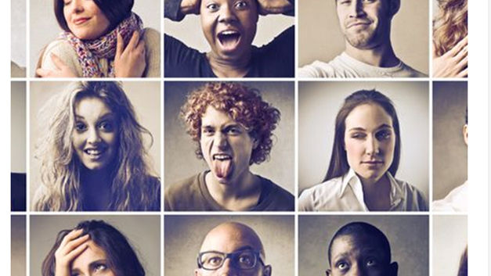
Methodologies
Data Collection and Preprocessing: Collecting data from various sources as previously outlined. Preprocessing involves cleaning, normalizing, and structuring the data for analysis. This includes noise reduction in audio data, image normalization, and text tokenization.
Feature Extraction: Identifying and extracting relevant features from each modality. For instance, extracting key facial landmarks from images, spectral features from audio, and semantic features from text.
Model Training and Validation: Applying machine learning algorithms to train the emotion detection model. This includes supervised learning techniques using labeled datasets. Validation involves assessing the model's performance using a separate dataset to ensure accuracy and reliability.
Fine-Tuning and Optimization: Fine-tuning the model parameters for optimal performance. This could involve hyperparameter tuning and testing different model architectures. Fine-tuning models can be intensive and expensive, therefore, we propose the use of methods to efficiently fine-tune parameters, like LoRA, QLoRA, Adapter Modules and BitFit, each of which only fine-tune a small subset of parameters to a great effect and will help tune the models for emotion recognition.

Slide 12

Roadmap
Data Refinement
Model Optimization
User Feedback
Deployment

Slide 13
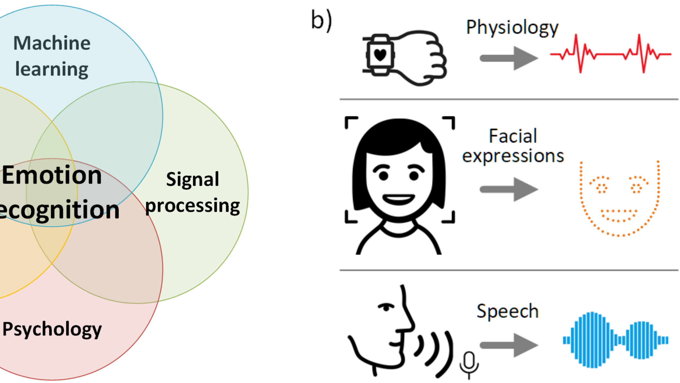
Conclusion
This project aims to develop a cutting-edge multimodal emotion detection system, leveraging the power of LLMs like LLaMa, LLaVa, and Wav2vec.
It stands at the intersection of technology, psychology, and user experience, aiming to bring a deeper understanding of human emotions to digital interactions.

Slide 14
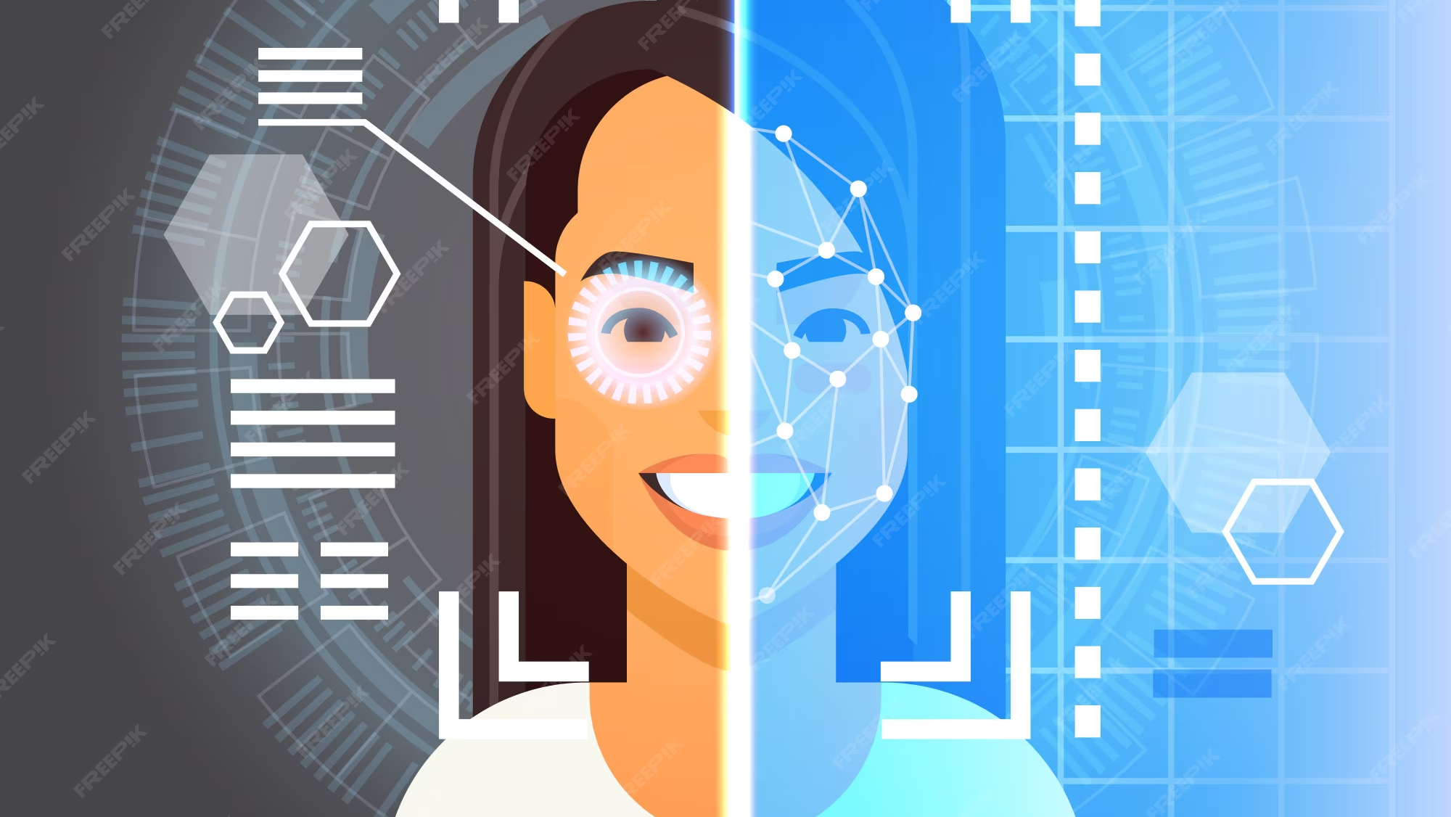
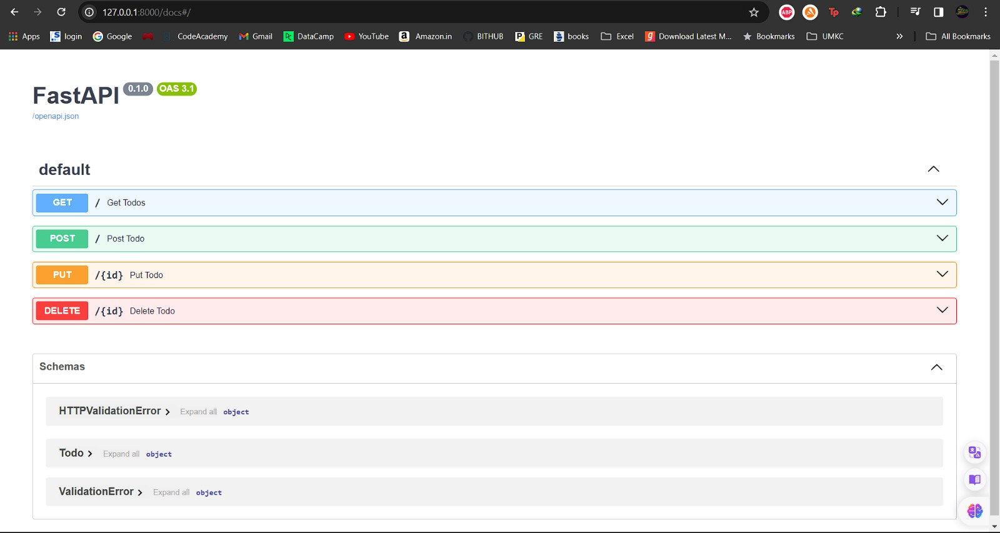
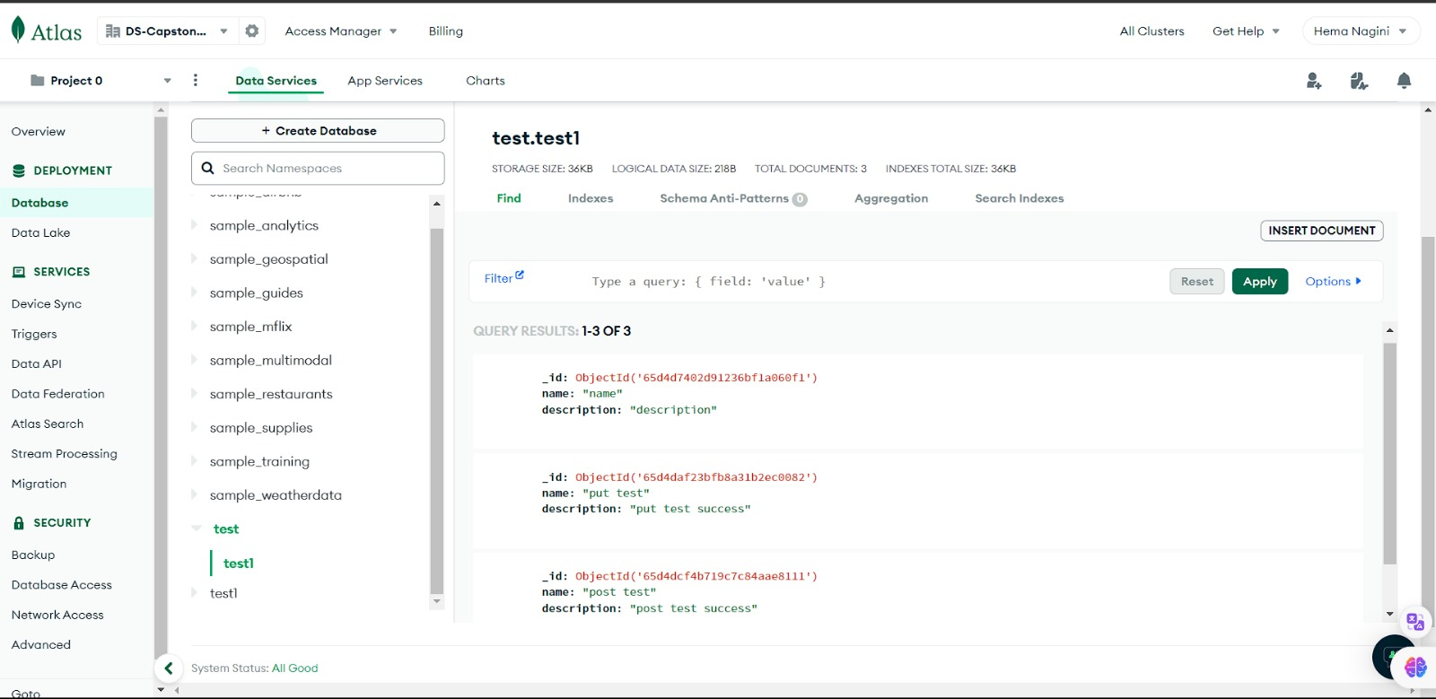
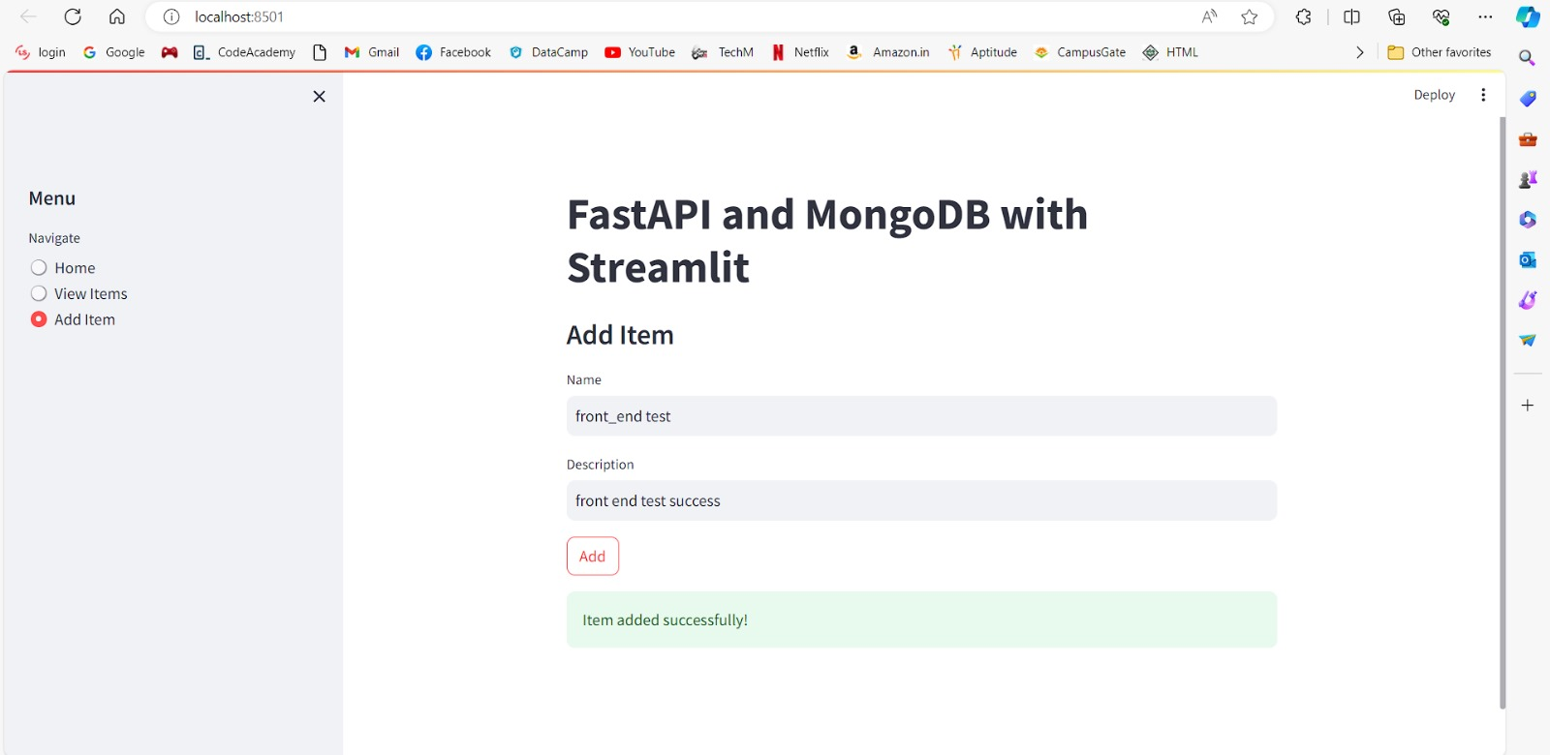
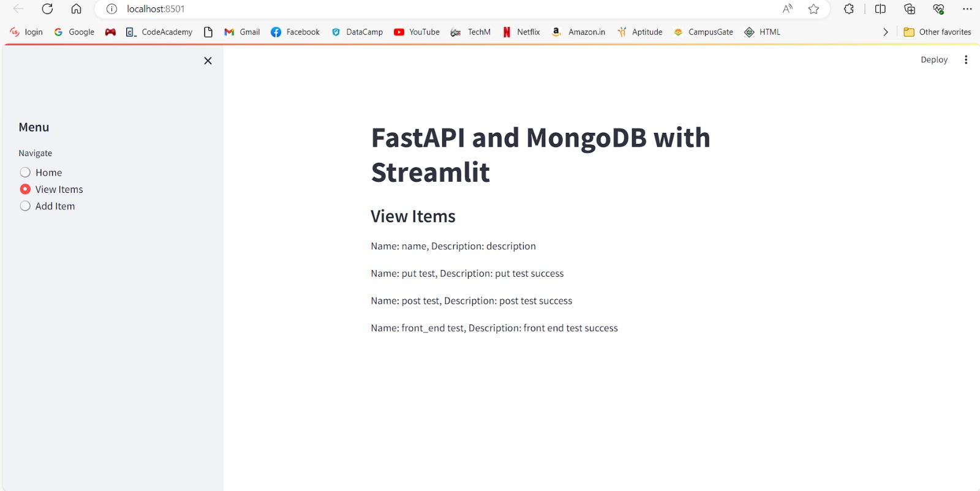
Partial Outcomes
FastAPI CRUD operation on MongoDB database
MongoDB
Posting data from streamlit through fastapi into MongoDB
Retrieving the data and displaying

Slide 15
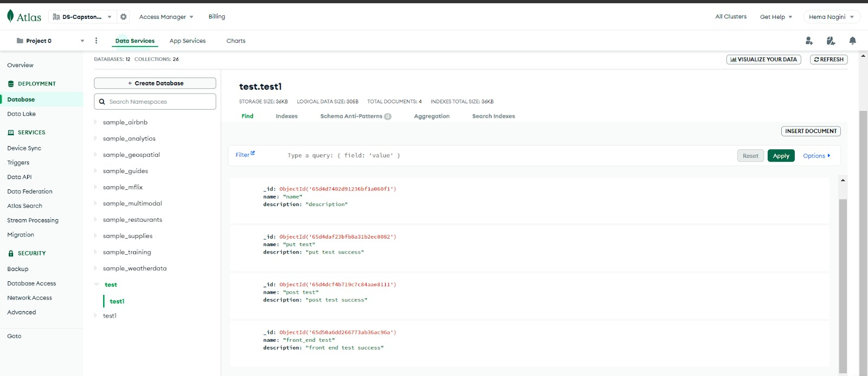
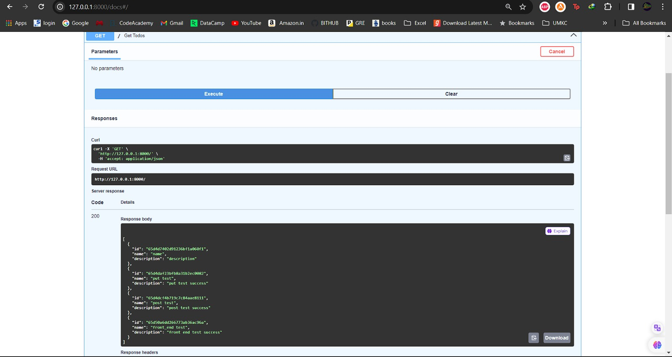
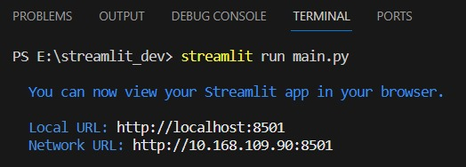
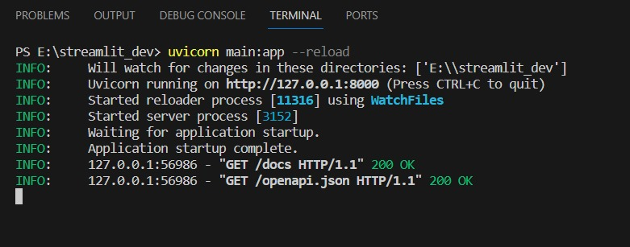
Verifying the added data from the frontend reflected in the FastAPI request
Verifying the data added through streamlit to the MongoDB database via FastAPI
Streamlit Run command
FastAPI run command

Slide 16
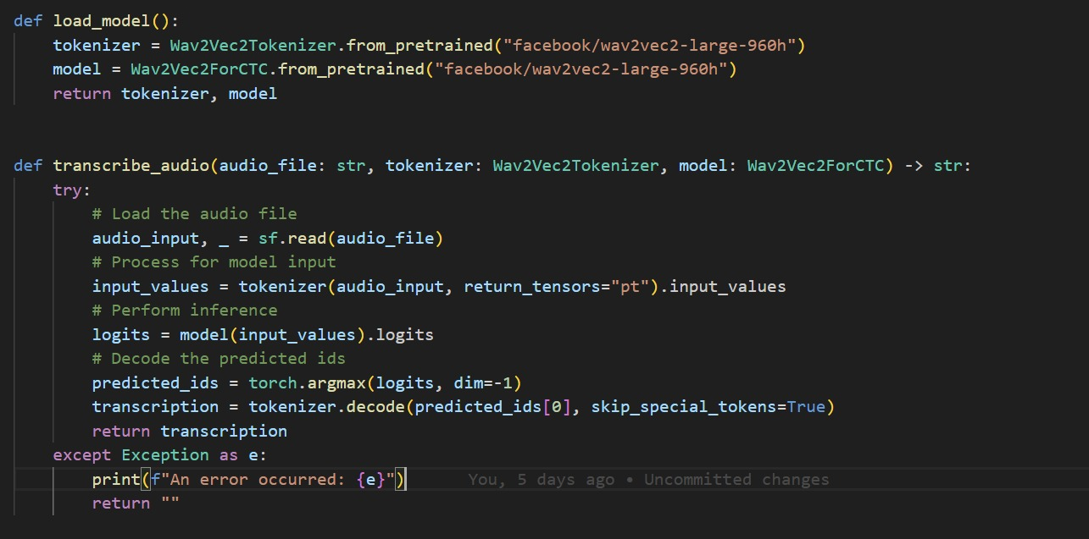
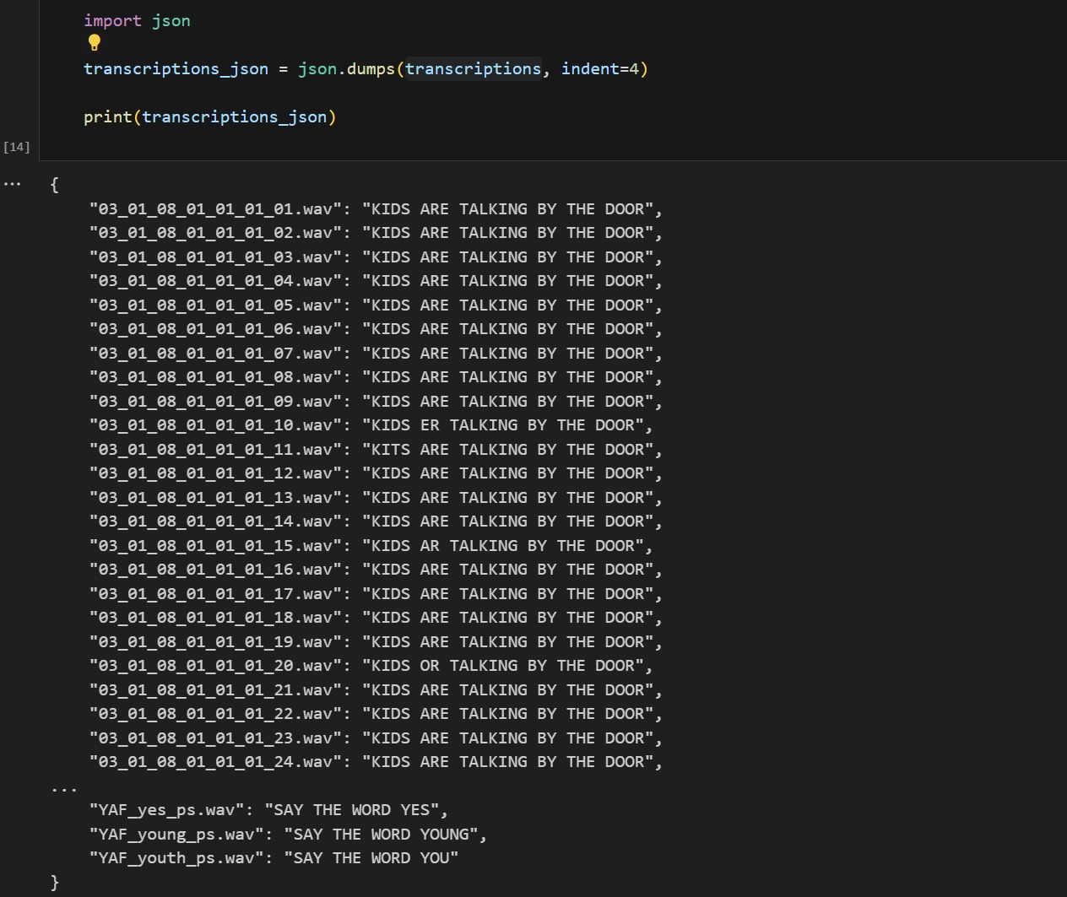
Audio to text using Wav2Vec model
Output

Slide 17

Thank You

